Slide 1

Credit Card Fraud Detection
Using Machine Learning Model
DSCI 631 - Fall 2022
Professor: Lei Wang
Group 05: Tien Nguyen, Luqing Qi, Will Wu
Notes:
Will

Slide 2
Introduction
Why credit card fraud detection? Why this topic?
Notes:
Will
Credit card fraud is one of the most common forms of virtual identity theft. It involves the unauthorized use of someone's credit card information to make purchases or transactions that are against the user's will. In our project, we hope to analyze our dataset and apply different machine learning algorithms in hopes to track patterns to predict and prevent abnormal credit card transactions.

Slide 3
Project Plan
Data Collection
EDA
Data Preprocessing
Model Development
Model Comparison
Model Hyperparameters Tuning
Model Evaluation
Notes:
Will

Slide 4
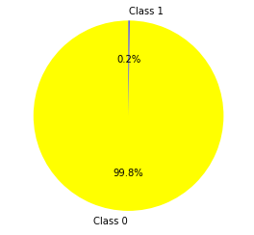
Dataset Overview
Dataset: Credit Card Fraud Detection
Source: Kaggle
284,807 observations, 30 features
No missing data
Imbalanced Dataset
Class 1 (fraud): 492
Class 0 (not fraud): 284,315
Features:
V1 -> V28, Time, Amount
Numerical
V1 -> V28: principal components obtained with PCA
https://www.kaggle.com/datasets/mlg-ulb/creditcardfraud
Notes:
Will

Slide 5
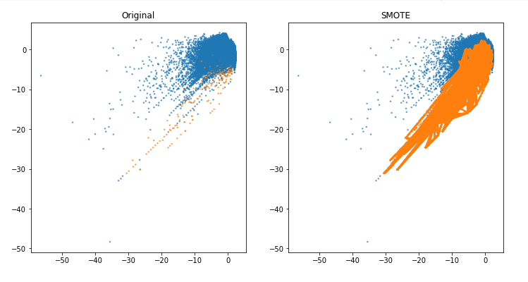
Preprocessing
The target variable is heavily imbalanced.
Oversampling to balance the dataset:
Split train/test
Apply SMOTE
Standardize with StandardScaler()
Notes:
Will

Slide 6
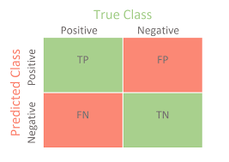
Machine Learning Models
Evaluation Metrics:
Baseline model: Dummy Classifier
Logistic Regression
Decision Tree
Naive Bayes
Main focus: Recall - We want to detect as much fraud transaction as possible
Others:
Precision
Accuracy
Visualization: Confusion Matrix
Notes:
Will

Slide 7
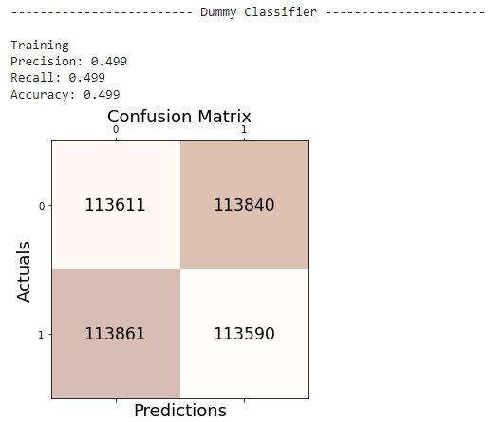
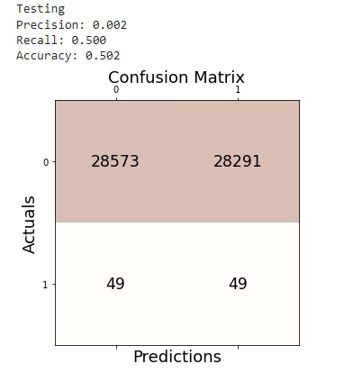
Baseline model: Dummy Classifier
from sklearn.dummy import DummyClassifier
DummyClassifier(strategy="uniform")
Notes:
Tien

Slide 8
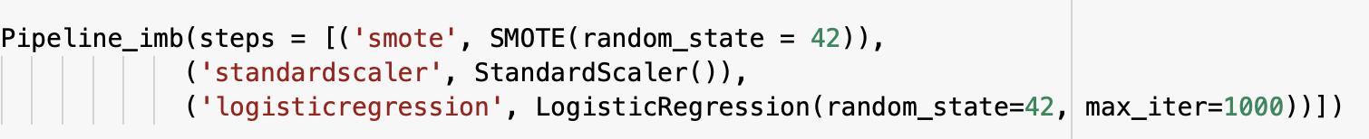
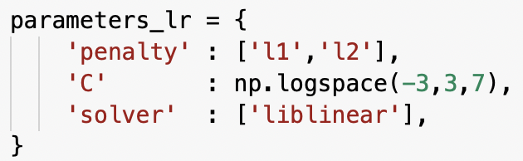
2) Logistic Regression
Logistic Regression pipeline:
GridsearchCV parameters tuning:
Best estimator: (score = Recall)
Notes:
Tien

Slide 9
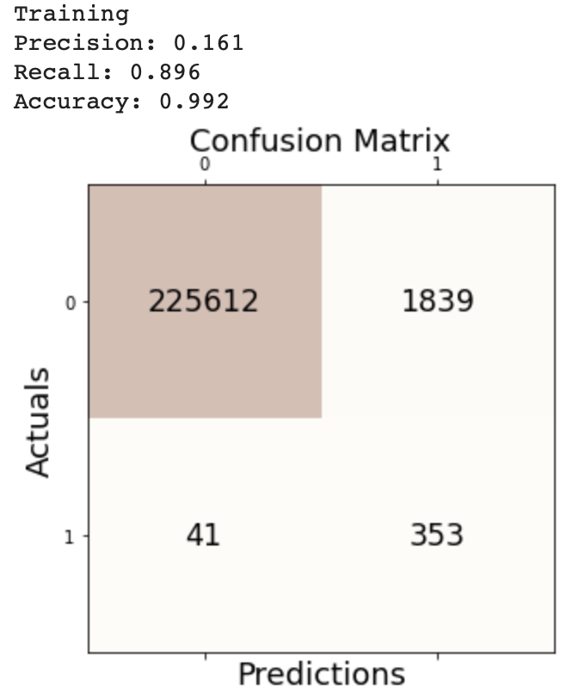
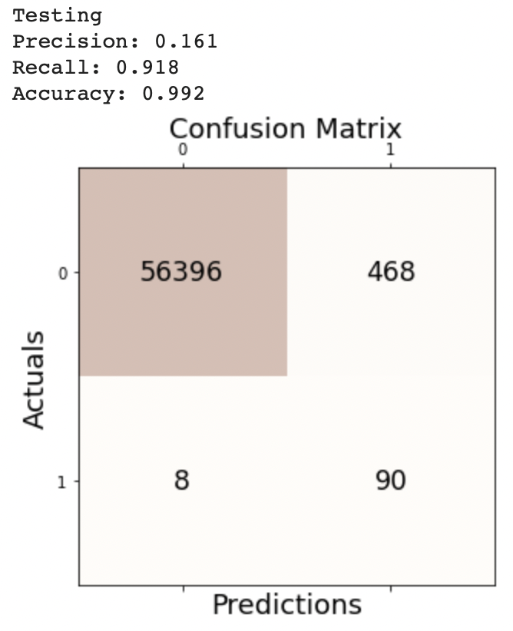
2) Logistic Regression
Notes:
Tien

Slide 10
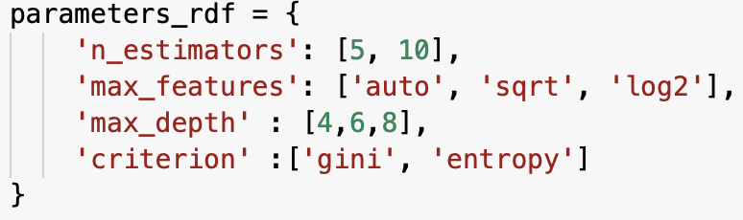
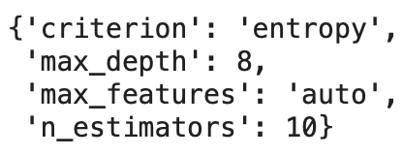
3) Random Forest
Random Forest pipeline:
GridsearchCV parameters tuning
Best estimator: (score = Recall)
Notes:
Tien

Slide 11
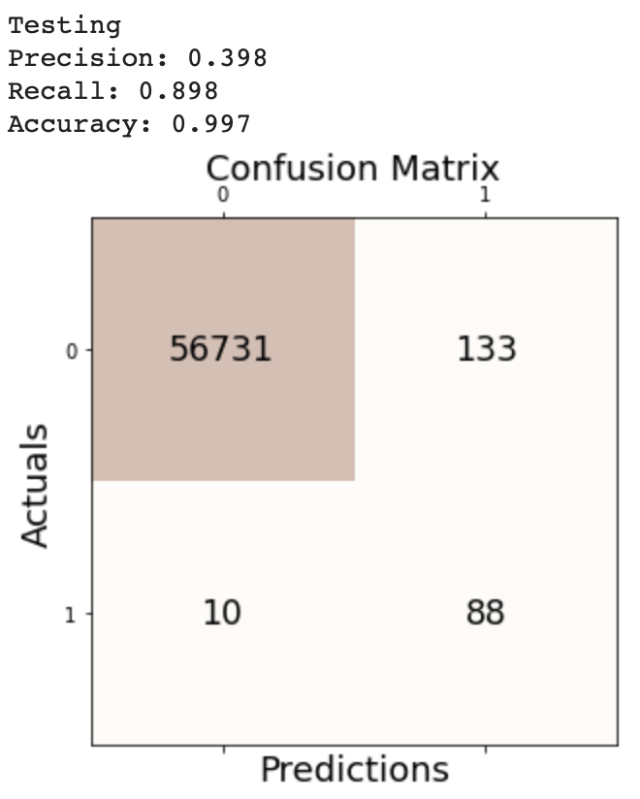
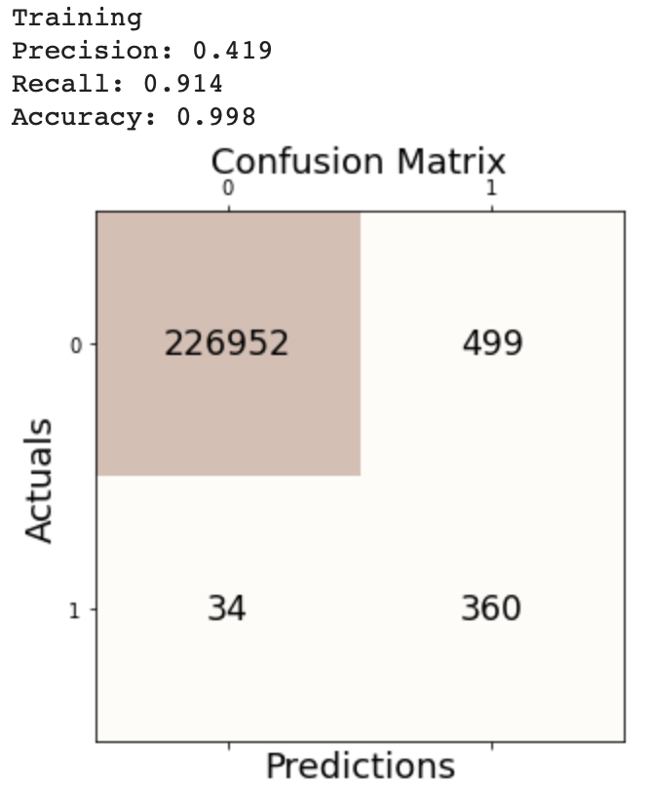
3) Random Forest
Notes:
Tien

Slide 12
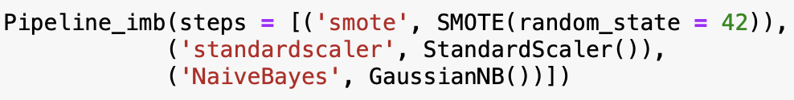
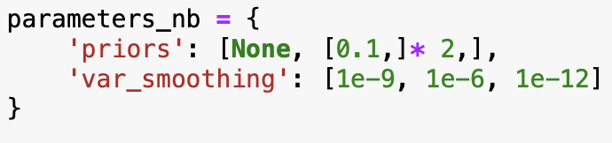
4) Naive Bayes
Naive Bayes pipeline:
GridsearchCV parameters tuning
Best estimator: (score = Recall)
Notes:
Tien

Slide 13
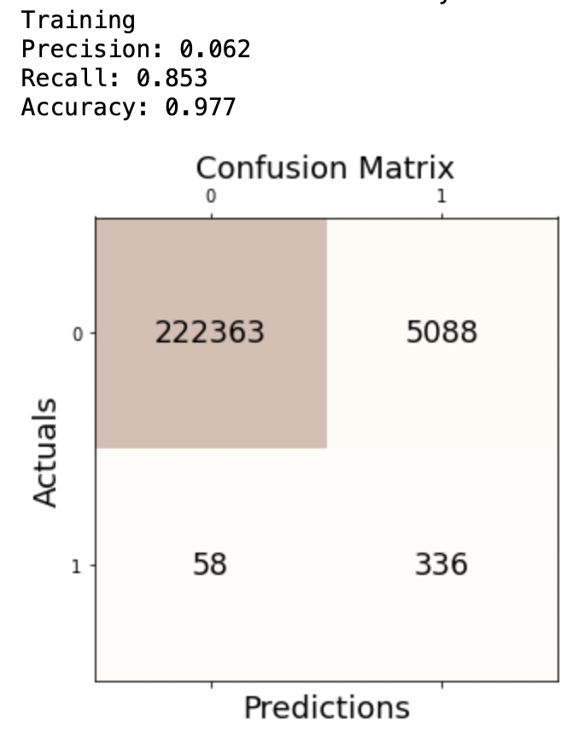
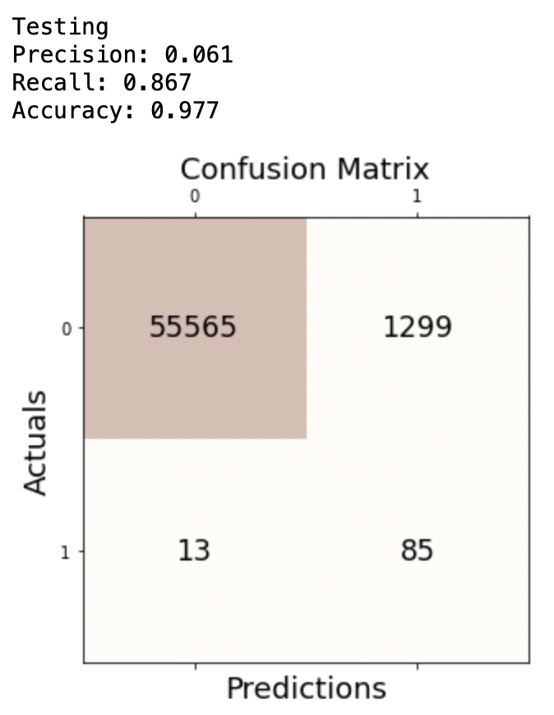
4) Naive Bayes

Slide 14
Models Comparison
Model | Train Recall | Train Precision | Train Accuracy | Test Recall | Test Precision | Test Accuracy
Dummy Classifier | 0.499 | 0.499 | 0.499 | 0.500 | 0.002 | 0.502
Logistic Regression | 0.896 | 0.161 | 0.992 | 0.918 | 0.161 | 0.992
Random Forest | 0.914 | 0.419 | 0.998 | 0.898 | 0.398 | 0.997
Naive Bayes | 0.853 | 0.062 | 0.977 | 0.867 | 0.061 | 0.977
Notes:
Tien

Slide 15
Regression using Neural Networks
20% Data in test data
Apply StandardScaler to standardize our data
Activation Function : RELU
Loss Function : Mean Squared Error
Optimizer : Adam
Metrics: Mean Absolute Error
Total Parameter: 12,289
Epochs : 200

Slide 16
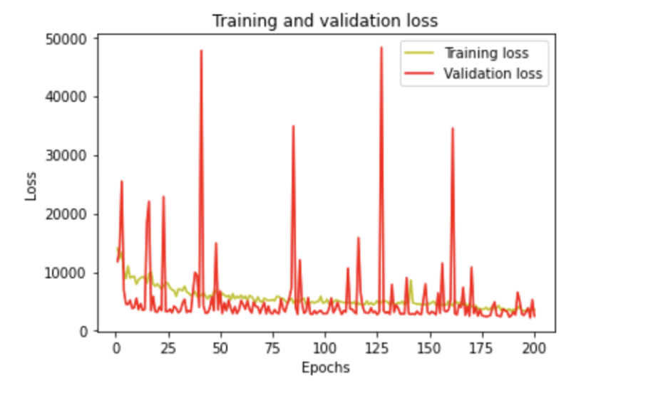
Mean Square Error: 5304.17
Mean Absolute Error:
38.15

Slide 17
Regression using Neural Networks and comparison to other models
 | Neural Networks | Linear Regression | Decision Tree | RandomForest
Mean Square Error
Mean Absolute Error

Slide 18
K-Mean Cluster
Using Elbow Method we found the best k = 3

Slide 19
Conclusion
Best model to detect fraud transaction:
Random Forest & Logistic Regression.
Limitations:
Meaning of each features
Future works:
Feature importance

Slide 20
Workload distribution
Task | Writing/Implementation | Editing
Project proposal | Tien
Model development | Tien | Tien
Presentation | Tien | Tien
Report | Tien
Notes:
Feel Free to add your name

